Slide 1
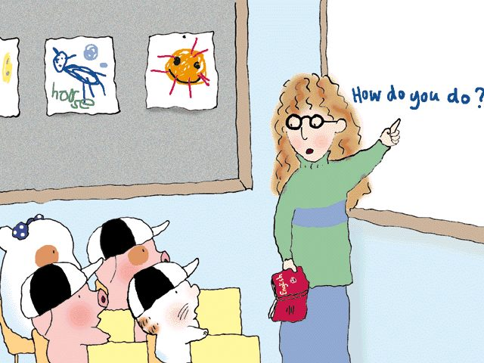
Direct and Indirect Speech

Slide 2

Content
I. Introduction
II. Conversion
III. Reported statements
- “Say”, “Tell”
IV. Reported questions
- Beginning with question words
- Not beginning with question words
V. Reported commands, requests etc.
VI. Exclamation and yes/no
VII. Mixed Type

Slide 3


Introduction
● Direct speech is the actual speech
quoted from the speaker
I am a social worker.

Slide 4


Introduction
● Indirect speech is the speaker’s
speech reported by the third person
He said he was a social worker

Slide 5

Mechanism of Converting Direct Speech into Indirect Speech (Rules)

Slide 6

Direct Speech to Indirect Speech
A) Put THAT before the Indirect Statement
e.g. He said, “The game is exciting.”
He said that the game was exciting.
B) SAID TO
TOLD

Slide 7
Direct Speech to Indirect Speech
C) Pronouns
Direct Speech | Reported Speech | Direct Speech | Reported Speech
I | He, she | Me | Him, her
We | They | Us | Them
You | He, she, they | You | Him, Her, them
My | His, her | Mine | His, hers
Our | Their | Ours | Theirs
Your | His, her, their | Yours | His, hers, theirs

Slide 8
Direct Speech to Indirect Speech
D) Verb Tense
Direct Speech | Reported Speech
Present Tense | Past Tense
Present Continuous Tense | Past Continuous Tense
Present Perfect Tense | Past Perfect Tense
Past
“Shall” + verb | “Would” + verb
Past Continuous Tense | Past Perfect Continuous Tense

Slide 9
Direct Speech to Indirect Speech
E) verbs are not changed in the usual way:
1. universal truth
2. definite past time
3. For MUST,
i) Remain unchanged if used to denote an
obligation
ii) Changed to WOULD HAVE TO if used to
express a necessity in the future
4. HAVE HAD and HAD is changed to HAD HAD.

Slide 10
Direct Speech to Indirect Speech
5. For WOULD, SHOULD, OUGHT TO,
HAD BETTER, MIGHT and USED TO,
verb is not changed.
6. Infinitives
7. SHALL WILL WOULD
unless SHALL is used to make a request for
instructions ( changed to SHOULD )

Slide 11
Direct Speech to Indirect Speech
F) Adverbs of time and place and some words
Direct Speech | Reported Speech | Direct Speech | Reported Speech
Here | There | The day before yesterday | Two days before
This | That | Three days ago | Three days before
These | Those | Last year | The year before
Now | Then | Tomorrow | The next day
Today | That day | The day after tomorrow | In two day’s time
This week | That week | Come | Go
Yesterday | The day before | Bring | Take

Slide 12


Reported statements
After reporting verbs
E.g. I am happy.
He says (that) he is happy.
He has said (that) he is happy.
He will say (that) he is happy.

Slide 13

Reported statements
Eternal truth
E.g. The boy said, ‘The earth goes round the
sun.’
The boy said that the earth goes round the
sun.

Slide 14


Reported statements
Using relative pronoun ‘that’ but it can be omitted.
E.g. He said, ‘I am tired.’
He said (that) he was tired.

Slide 15
Reported statements
NB—SAID TO is usually changed to TOLD in reported speech.
E.g. He said to her, ‘I am tired.’
He told her that he was tired.

Slide 16
Reported statements
Exercise :
“I shall be there in time,” said Tom
Ans.
Tom said that he would be there in time

Slide 17

Reported Questions
● Introduced with verbs :
asked, inquired, wondered, wanted to know,
tried to find out, etc
  NEVER introduced with “said”
● Relative pronoun “that” is NEVER used
● “?” is replaced by “.” at the end
● There are two types:
   Beginning with question words
   Not beginning with question words

Slide 18

Beginning with question words
E.g.1.
“Where have you been this afternoon?” the mother asked her son.
The mother asked her son where he had been that afternoon.

Slide 19

Beginning with question words
E.g.2.
“Which subject you like most?” the teacher asked the students.
The teacher asked the students which subject they liked most.
* Note: Subject comes before the verb.

Slide 20
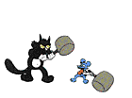
Not beginning with question words
E.g.1.
“Did you watch TV last night?” Tom asked me.
Tom asked me whether I had watched TV the night before.

Slide 21
Not beginning with question words
E.g.2.
“Can you answer this question?” the teacher asked John.
The teacher asked John if he could answer that question.

Slide 22
Reported Questions
Exercise :
“What are you studying?” he asked her.
Ans.
He asked her what she was studying.
“Do you like the apple?” the farmer asked Bill.
Ans.
The farmer asked Bill if/whether he liked the apple.

Slide 23
Report commands
Verb giving a order becomes an infinitive
Verb ‘said’ becomes
‘told, ordered, asked, commanded, requested, begged, etc.’
Add the person to whom the order was given
- negative commands are changed in the same way with ‘not’

Slide 24

Report commands
E.g. 1: “Touch your toes, “he said to us.
He told us to touch our toes.
E.g. 2: “Don’t lie down!” he said to me.
He ordered me not to lie down.

Slide 25
Report commands
Exercise :
“Fire!” the lieutenant said.
Ans.
The lieutenant commanded his soldiers to fire.

Slide 26

Exclamation and yes/no
No definite rules for changing into indirect speech
Often use ‘say, remark, exclaim, greet, shout, give exclamation of surprise ,etc.’

Slide 27
Exclamation and yes/no
E.g.1 .
“What a big house!” he said.
He said/exclaimed that it was a big house
E.g.2.
“Hi, John,” Tom said. “Lovely day, isn’t it!”
Tom greeted John and remarked that it was a lovely day.

Slide 28
Exclamation and yes/no
Yes/no are reported by subject + auxiliary verb (do, does, did, etc)
E.g.1.
“Have you had your lunch?” Sam asked. “Yes,” Paul replied.
Sam asked Paul if he had had his lunch and Paul replied that he had

Slide 29
Exclamation and yes/no
E.g.2.
“Did you watch the TV programme last night?” Mary asked Sue. “No,” Sue replied.
Mary asked Sue if she had watched the TV programme the night before and Sue replied
that she had not

Slide 30
Exclamation and yes/no
Exercise :
“How poor the report is!” the manager said.
Ans.
The manager remarked that the report was poor.

Slide 31

Mixed Type
Suitable introductory verb.
E.g.1
‘‘Don’t play with that knife, Sally,’’ Mrs. Chan said. ‘‘You’ll hurt yourself.’’
Mrs. Chan told Sally not to play with the knife and added that she would hurt herself.

Slide 32

Mixed Type
E.g.2
‘‘You look beautiful in that dress, Jane,’’ Paul said. ‘‘How much did it cost you.’’
Paul told Jane that she looked beautiful in the dress and asked her how much it had cost her.

Slide 33
Mixed Type
Use either as/because/since or a participle
E.g.1
‘‘Where did you buy that dress, Sue? I’d like to get one for my sister,’’ James said.
James wanted to know where Sue had bought the dress, as he wanted to get one for his sister.

Slide 34

Mixed Type
E.g.2
‘‘Don’t go to bed late. Remember you’ll have to get up early tomorrow,’’ Peggy’s mother said.
Peggy’s mother told her not to go to bed late, reminding her that she would have to get up early the next day.

Slide 35
Mixed Type
Exercise :
“Do you like to have a bowl of rice?” the chef said to John, “We don’t have any other food here.”
Ans.
The chef asked John if/whether he liked to have a bowl of rice and said that they don’t have any other food there.

Slide 36
        THANK YOU.

